Slide 1

Control Statements (1)
University of Human Development College of Science and Technology Department of IT
Lecture :Programming
Lecturer: Tara Qadr
1st stage 2015-2016

Slide 2
Objectives
To use Boolean expressions to control selection statements.
To implement selection control using if and nested if statements.
To implement selection control using switch statements.
To write expressions using the conditional operator.

Slide 3
Control Statements
Normally, statements in a program are executed in the order in which they were written.
Java provides two other ways to change the flow of control:
Selection Statements
If and if...else Statements
Switch Statements
Conditional Operator
Repetition Statements
while Statement
do-while Statements
for Statements

Slide 4

Selection Statements
If and if...else
Switch Statements
Conditional Operator

Slide 5
flowcharts
Some of the common symbols used in flowcharts are shown below:
The flow of data between steps is indicated by arrows, or flow lines.
Terminator
Process
Input/Output
Decision
Preparation
(Initialization)

Slide 6
Example: draw a flow chart to sum two numbers and print the result and the numbers.
import java.util.Scanner;
public class SumTwoNumbers {
public static void main ( String[ ] a) {
Scanner input = new Scanner( System.in );
int x,y,z;
x =input.nextInt();
y =input.nextInt();
z=x+y;
System.out.println("x="+x + " y="+ y + " z=" +z);
}
}
Start
Input x, y
z = x + y
Print x, y, z
Stop

Slide 7
Conditional Examples (1)
We often want to do something only under certain conditions:
If student’s grade is greater than or equal to 50 then the student passed the exam.
If a number is divided by 2 then it is even.
If age is less than 5 then price of ticket is cheaper.
If age is greater than or equal 18, then you can get driver’s license.

Slide 8
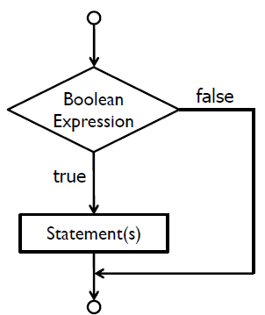
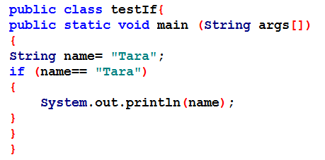
If Statements
A simple if statement executes an action if and only if the condition is true.
General syntax:
if (boolean Expression) {
statement(s);
}

Slide 9
Boolean expressions
Write Boolean expressions using relational operators
A Boolean expressions(or condition)often uses one of Java's six relational operators:
◦==, !=, <, >, <=, >=
Example: age >= 18

Slide 10
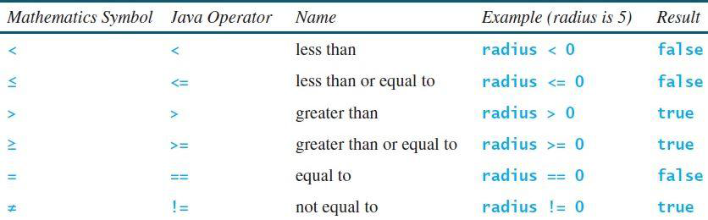
Equality and Relational Operators
Determines if one operand is greater than, less than, equal to, or not equal to another operand.

Slide 11
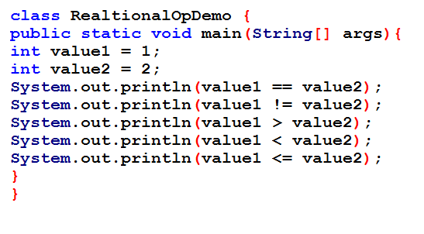
Example: Equality and Relational Operators

Slide 12
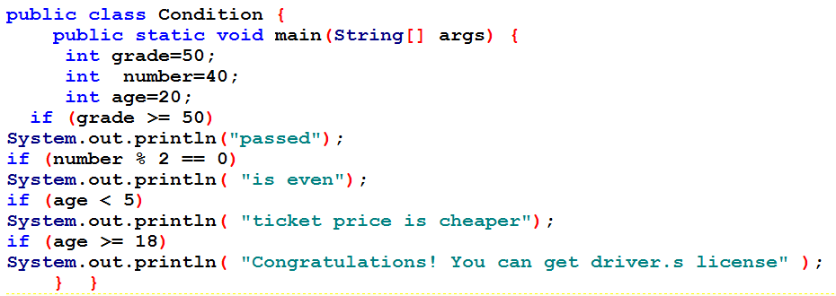
Conditional Examples

Slide 13
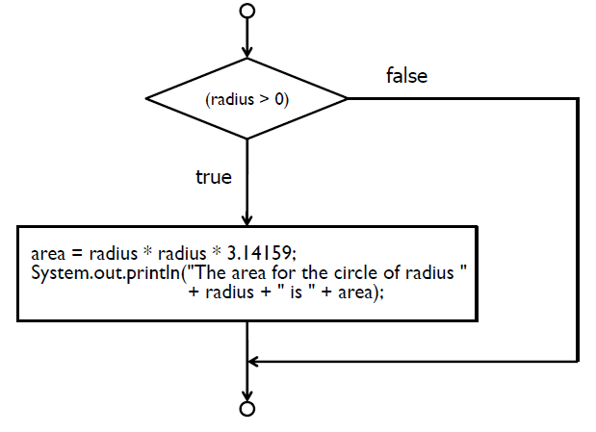
Example : Find Area of Circle
Consider we want to find the area of a circle if and only if the radius of the circle is a positive number.

Slide 14
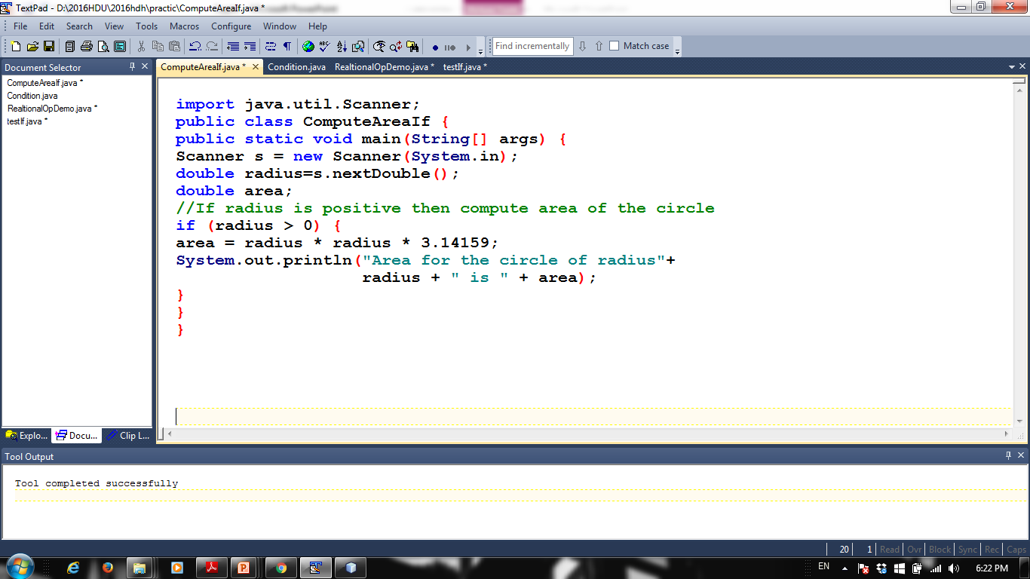
Find area of circle using if

Slide 15
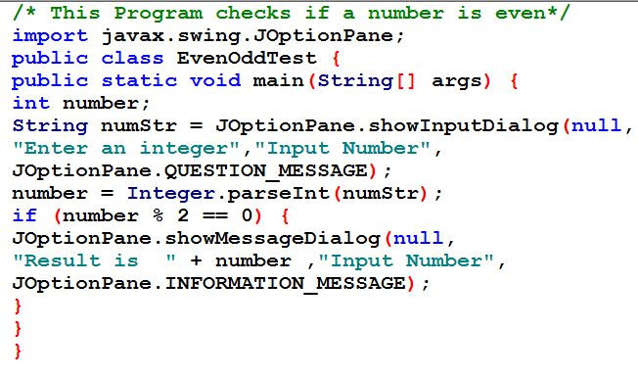
Write a program to determine if a number is even.

Slide 16
Multiple if Statements
In example3, what happens if the number is not even.
The program shows no messages.
What if you want to print a message when the number is not even.
Multiple if statements can be written in the same program.
Rewrite example 3 to include that the number is not even (or the number is odd).

Slide 17
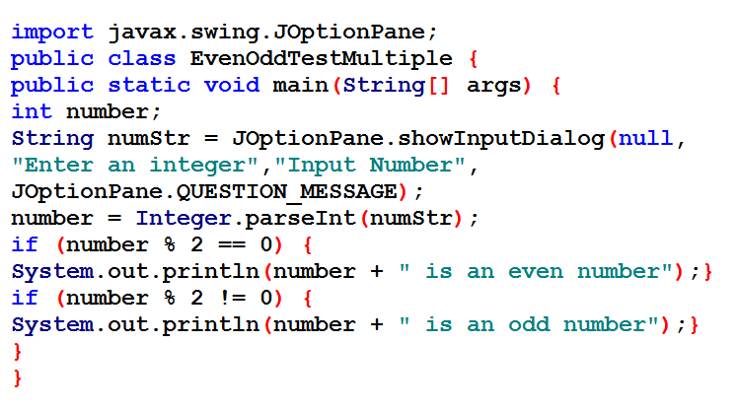
Write a program to determine if a number is even or odd using multiple if statement

Slide 18
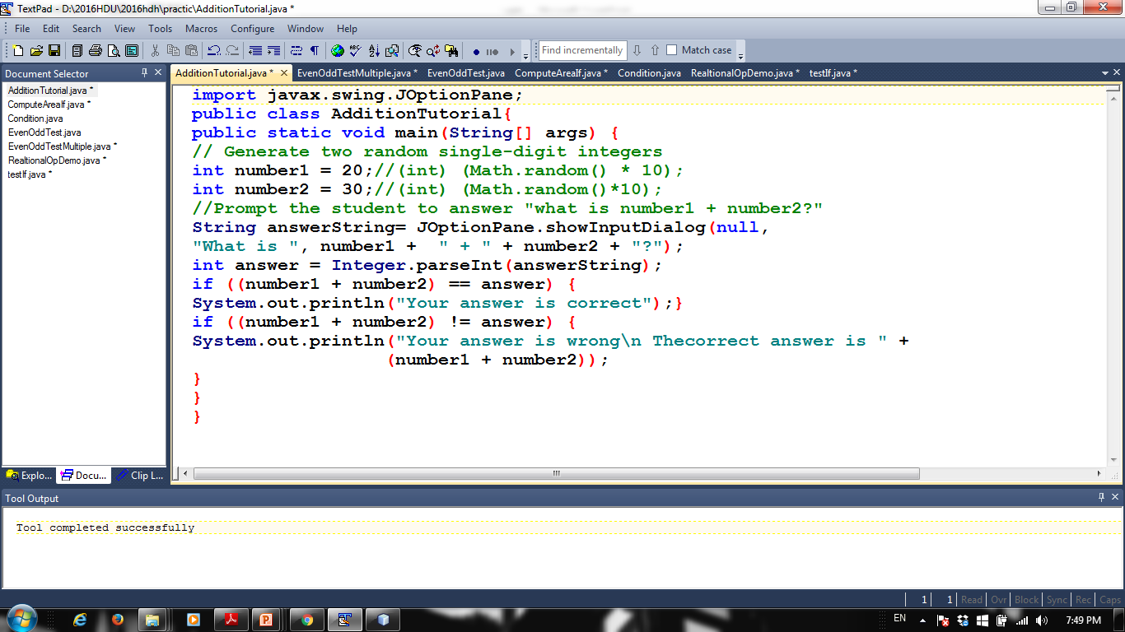
This Program checks if the user’s answer of adding two numbers is correct or not

Slide 19
The if...else Statement
A simple if statement takes an action if the specified condition is true. If the condition is false, nothing is done.
But what if you want to take alternative actions when the condition is false?
You can use an if...else statement.
if...else Executes one block if a test is true, another if false.
Examples:
If student’s grade is greater than or equal to 50 then the student passed the exam else the student is failed.
If a number is divided by 2 then it is even, else it is odd.

Slide 20
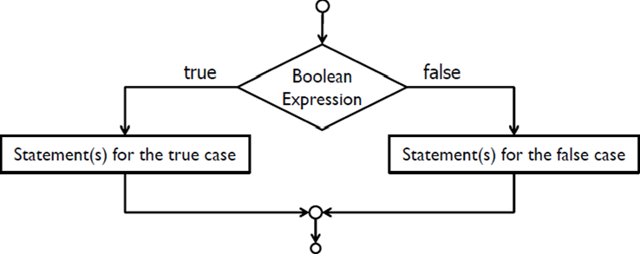
The if...else Statement (Cont.)
General Syntax:
if (boolean Expression) {
statement(s)-for-the-true-case;}
else {
statement(s)-for-the-false-case;
}

Slide 21
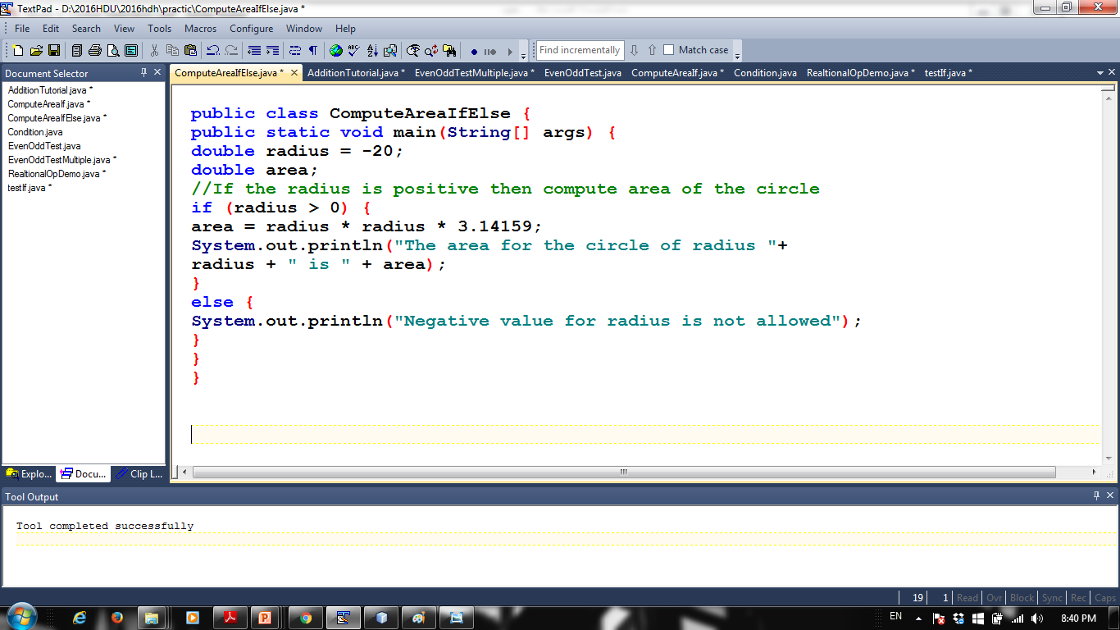
if...else Example :(Find Area of Circle)

Slide 22
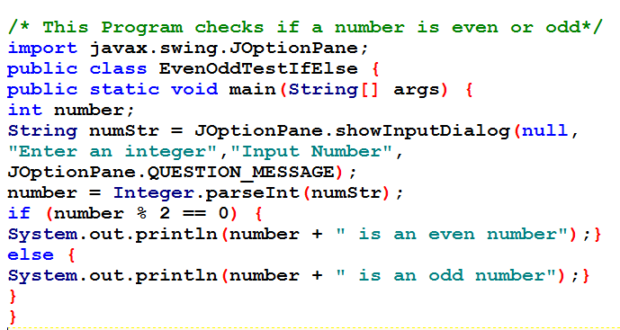
if...else Example

Slide 23
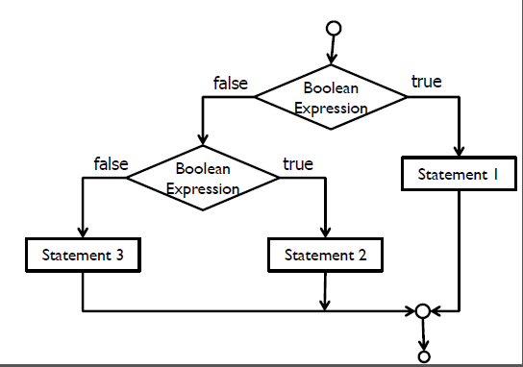
if...else if
Chooses between outcomes using many tests.
General Syntax:
if (boolean Expression) {
statement(s);
} else if (boolean Expression) {
statement(s);
} else {
statement(s);
}

Slide 24
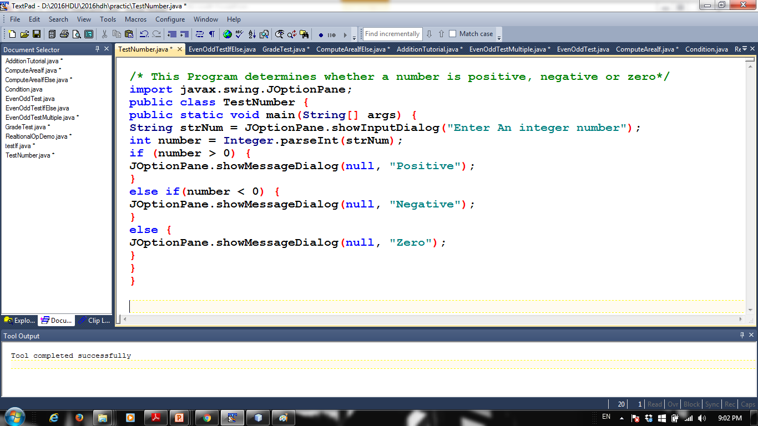
Example1: if...else if

Slide 25
if...else if Example 2
Write a program, to convert students score to its equivalent grade as follows:
A for exam grades greater than or equal to 90,
B for grades 80 to 89,
C for grades 70 to 79,
D for grades 60 to 69 and
F for all other grades.

Slide 26
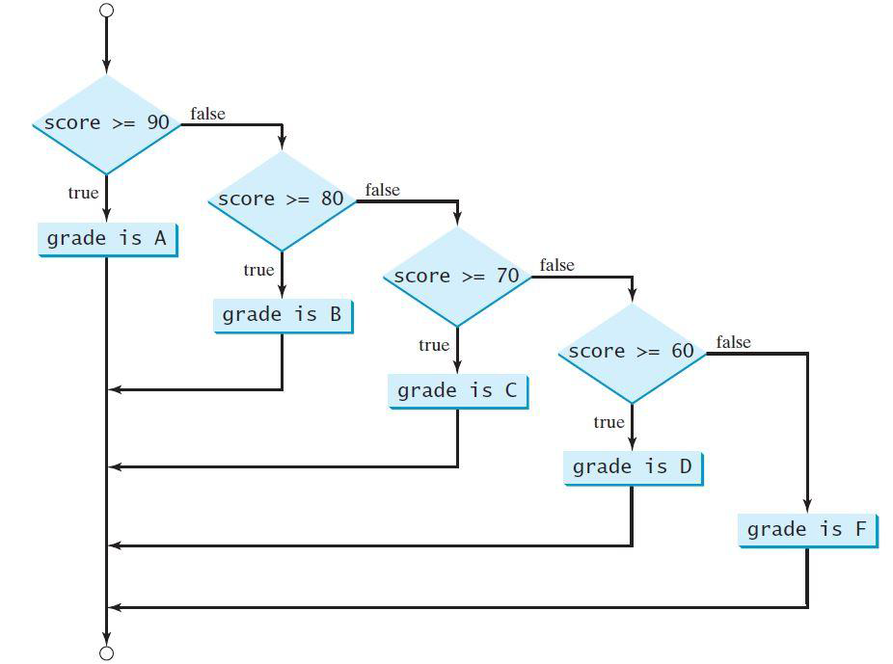
Flowchart for Examples 2

Slide 27
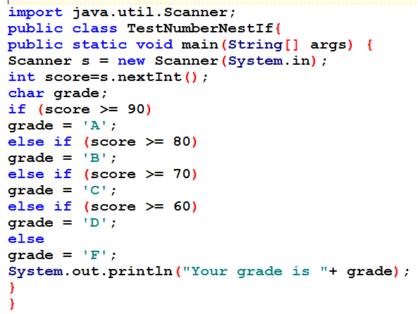
solution

Slide 28
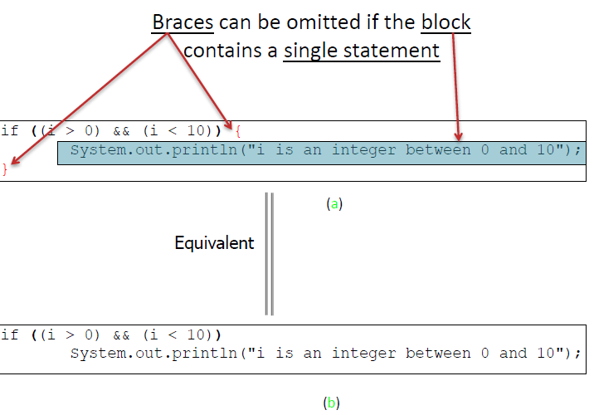
NOTE

Slide 29
Nest if-else statements
It is always legal to nest if-else statements which means you can use one if or else if statement inside another if or else if statement.:
int i = 1; int j = 2; int k = 3;
if (i > j) {
if (i > k){
System.out.println("A");
}
}
else {
System.out.println("B");
}

Slide 30
Homework (1)
Write a program that finds the biggest value between three numbers.
Write a program to determine if a number is divisible by 5 or 2 or both.
Write a program that prompts the user to enter a number between 1 and 7, then converts the numbers to the day of week it corresponds as follows:
.1 Saturday
.2 Sunday
.3 Monday
.
.
.7 Friday

Slide 31
Homework (2)
Write a program that does the followings:
Lets the user to:
Enter student’s marks.
Enter character:
a if the student completed class 12 with first year and first trial.
b if the student completed class 12 with first year and second trial.
c if the student completed class with more than one year.
If the student is:
In class a then add 3 to the marks
In class b then add 1 to the marks
In class c then the student does not take any additional marks

Slide 32
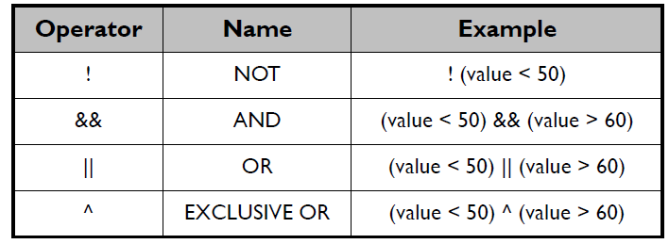
Logical Operators (1)
Logical operators are used to form more complex conditions by combining simple conditions.
Examples:
((number1 > number2) && (number1 > number3))
((num % 2 == 0) || (num % 3==0))
Binary logical operators have lower precedence than relational operators (they will be evaluated after)

Slide 33
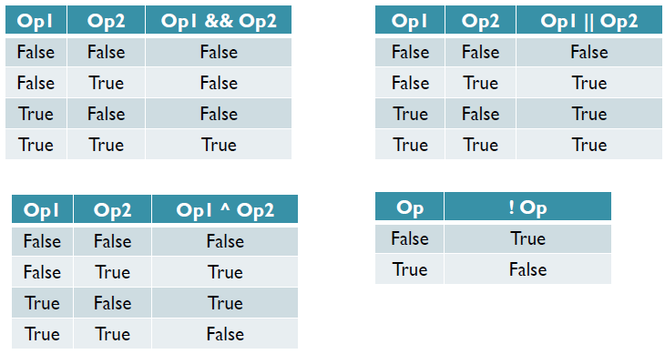
Logical Operators (2)
Logical Operators Truth Table

Slide 34
Switch Statement (1)
Overuse of nested if statements makes a program difficult to read.
Switch statement provides another way to decide which statement to execute next.
Switch statement executes statements based on the value of a variable or an expression.
Switch statement evaluates an expression, then attempts to match the result to one of several possible cases.
Each case contains one value and a list of statements.
The flow of control transfers to statement associated with the first case value that matches.

Slide 35
Switch Statement (2)
The general syntax of a switch statement is:
switch ( expression ){
case value1 :statement-list1;
break;
case value2 :statement-list2;
break;
case value3 :statement-list3;
break;
case ...
default: statement-list;
}
Switch
And
Case
Are
reserved words

Slide 36
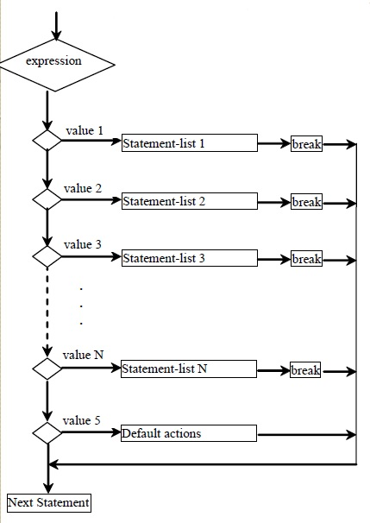
switch Statement Flow Chart

Slide 37
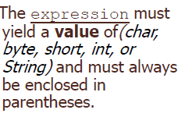
Switch Statement Rules (1)
switch ( expression ){
case value1 :statement-list1;
break;
case value2 :statement-list2;
break;
case value3 :statement-list3;
break;
...case
value N: statement-list N;
break;
default : statement-list;
}

Slide 38
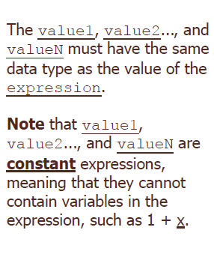
Switch Statement Rules (2)
switch ( expression ){
case value1 :statement-list1;
break;
case value2 :statement-list2;
break;
case value3 :statement-list3;
break;
...case
Value N: statement-list N;
break;
default: statement-list;
}

Slide 39
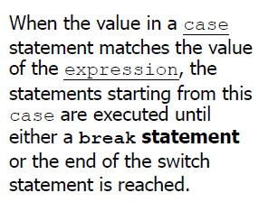
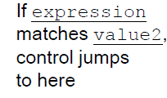
Switch Statement Rules (3)
switch ( expression ){
case value1 :statement-list1;
break;
case value2 :statement-list2;
break;
case value3 :statement-list3;
break;
...case
Value N: statement-list N; break;
default: statement-list;
}

Slide 40
Switch Statement Rules (5)
switch ( expression ){
case value1 :statement-list1; break;
case value2 :statement-list2; break;
case value3 :statement-list3; break;
...case value N: statement-list N;
break;
default : statement-list;
}
The default case is optional, can be used to perform actions when none of the specified cases matches the expression.
•The default case has no associated value.

Slide 41
Switch Statement Rules (6)
The expression cannot be a boolean value or a floating point value (float or double)
The implicit boolean condition in a switch statement is equality
You cannot perform relational checks with a switch statement

Slide 42
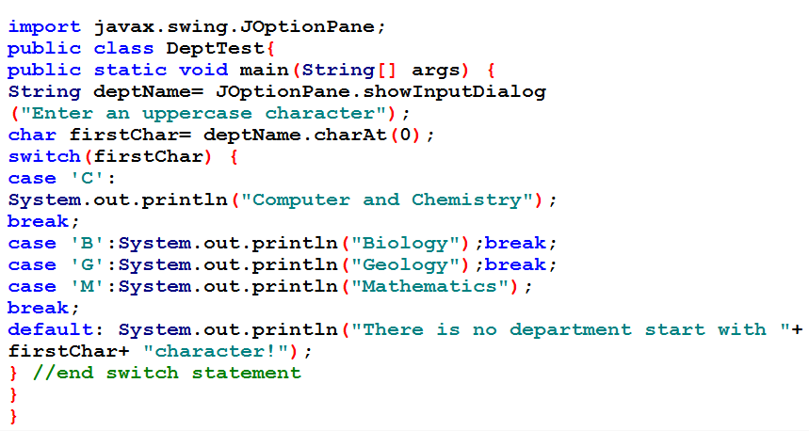
Example1: switch Statement
/* This program prints name of the department(s)
in Faculty of Science depending of input character
of the user using switch statement*/

Slide 43
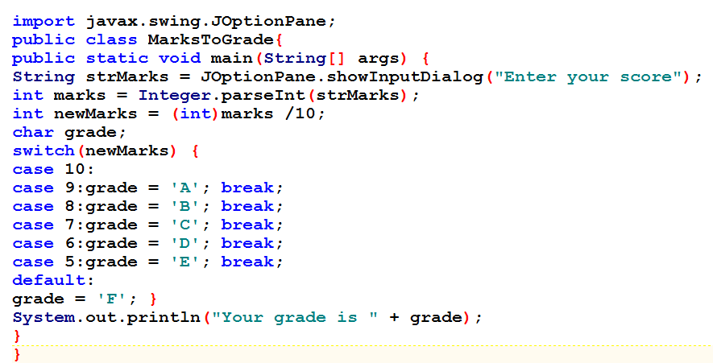
Example 2: switch Statement

Slide 44
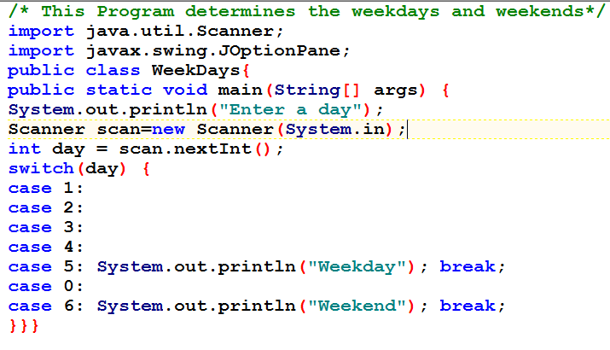
Example 3: switch Statement

Slide 45
Reference
http://docs.oracle.com/javase/tutorial/java/nutsandbolts/datatypes.html
http://www.javatpoint.com/variable-datatype
http://math.hws.edu/javanotes/c1/s4.html
INTRODUCTION TO JAVA PROGRAMMING COMPREHENSIVE VERSION 10th Edition
Paul Deitel , “Java How to Program”, 9thed.

Slide 46
THANK YOU

